Slide 1
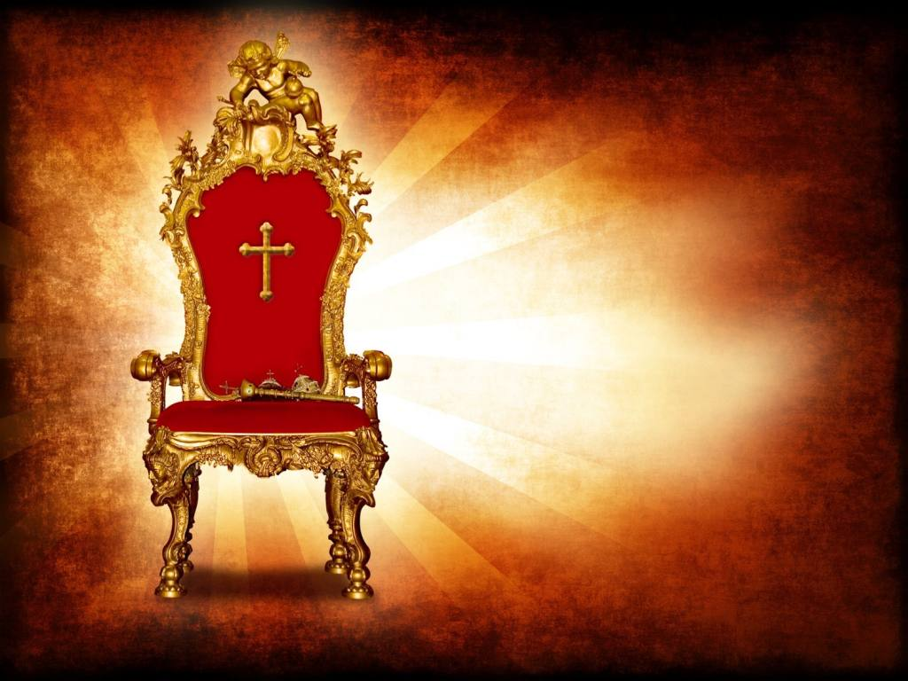
Keith Glasgow – 30/10/22
Sermon
of the
Monarch

Slide 2
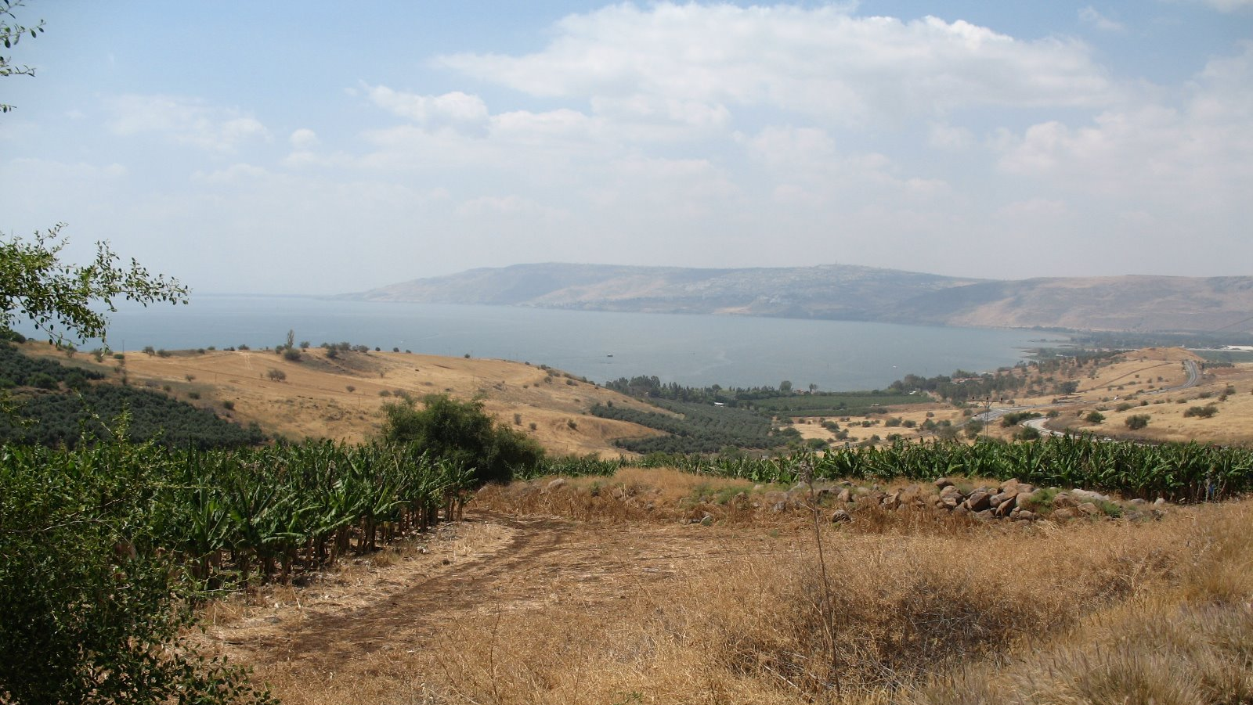
Our Approach in Prayer

Slide 3
The King's Manifesto

Slide 4
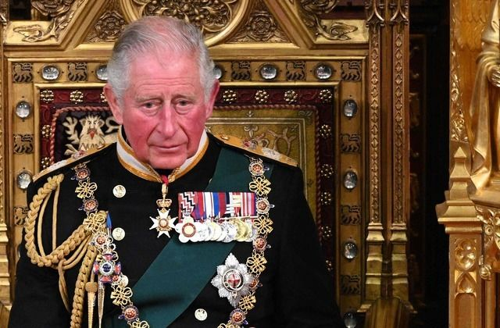
King Charles lll

Slide 5
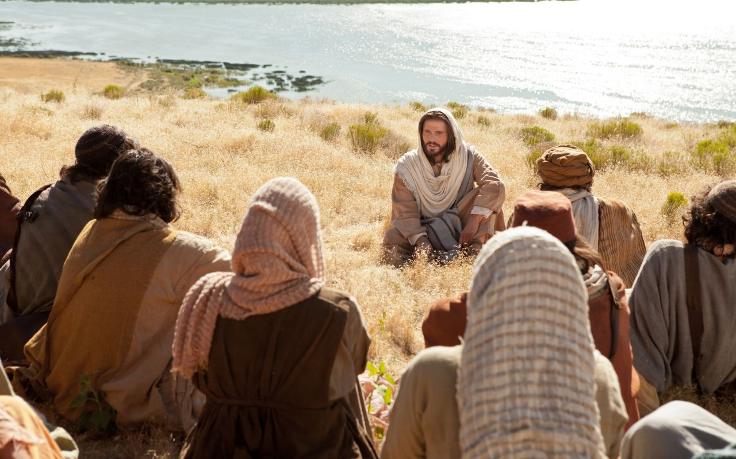
TODAY:
A New Distinctive
Matthew 5:1-16

Slide 6
Matthew 5:1-16
Seeing the crowds, He went up on the mountain, and when He sat down, His disciples came to Him. And He opened His mouth and taught them, saying:
“Blessed are the poor in spirit, for theirs is the kingdom of heaven.
“Blessed are those who mourn, for they shall be comforted.
“Blessed are the meek, for they shall inherit the earth.

Slide 7
“Blessed are those who hunger and thirst for righteousness, for they shall be satisfied.
“Blessed are the merciful, for they shall receive mercy.
“Blessed are the pure in heart, for they shall see God.
“Blessed are the peacemakers, for they shall be called sons of God.
“Blessed are those who are persecuted for righteousness' sake, for theirs is the kingdom of heaven.

Slide 8
“Blessed are you when others revile you and persecute you and utter all kinds of evil against you falsely on my account. Rejoice and be glad, for your reward is great in heaven, for so they persecuted the prophets who were before you.
“You are the salt of the earth, but if salt has lost its taste, how shall its saltiness be restored? It is no longer good for anything except to be thrown out and trampled under people's feet.

Slide 9
“You are the light of the world. A city set on a hill cannot be hidden. Nor do people light a lamp and put it under a basket, but on a stand, and it gives light to all in the house. In the same way, let your light shine before others, so that they may see your good works and give glory to your Father who is in heaven.

Slide 10
A New Distinctive
Matthew 5:1-16

Slide 11
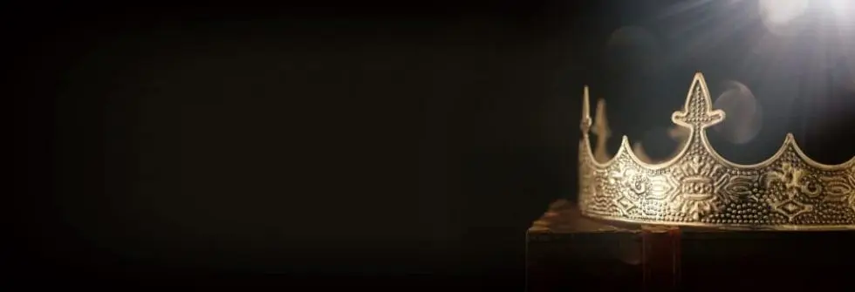
A New Distinctive:
1. In the way we relate
to God
(verses 3-6)

Slide 12
favoured by God, therefore
seen to be blessed
When God blesses us, He is showing His approval of us.

Slide 14
A deep sense of personal unworthiness

Slide 15
Godly sadness leads to godly comfort

Slide 16
humble before God and people

Slide 18
A New Distinctive:
2. In the way we relate
to God
to others
(verses 7-12)

Slide 19
I received mercy, so I treat others the same way

Slide 20
Moral purity before God, and sincerity before people

Slide 21
Maintaining peace between yourself and others,
and helping others make peace with each other

Slide 22
“Suffering is the badge of discipleship” (Bonhoeffer)

Slide 23
A New Distinctive:
3. In the way we relate
to God
to others
to the world
(verses 13-16)

Slide 24
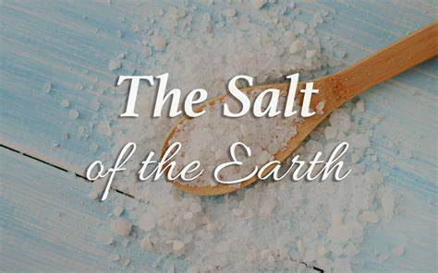
We are to be different
(a preserving influence in a corrupt world)

Slide 25
We are to be noticed
(a penetrating influence in a dark world)
You are the light of the world

Slide 26
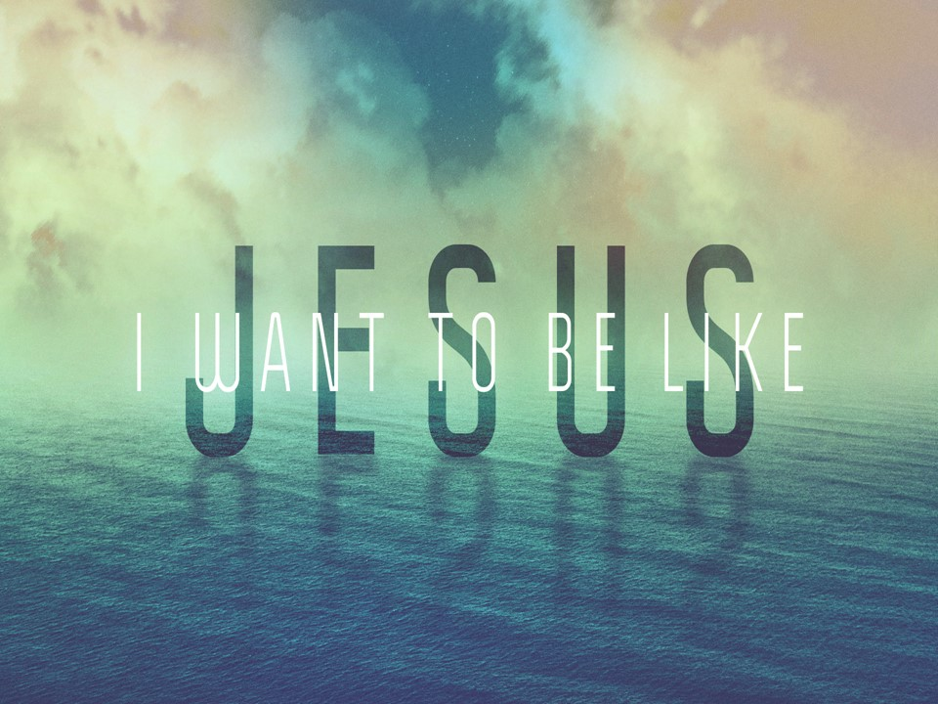
In the way I relate to God,
to others, and to the world

